Slide 1


COMPTER NETWORKS PROJECT
VR SIDDHARTHA ENGINEERING COLLEGE
DEPARTMENT OF INFORMATION TECHNOLOGY
Sessional-II
Presented by
A.Charan - 208W1A1268
C.Heman Sai - 208W1A1277
Mohammad Rizwanullah - 208W1A1299
N.Ajay Kumar Varma - 208W1A12A1

Slide 2

Bluetooth Chat Application
usage OF Bluetooth to send and receive the messAges.

Slide 3
AIM:
Developing a Bluetooth chat application for sending and receiving messages through Bluetooth.

Slide 4
Description:
Two devices are able to use Bluetooth to set up a secure peer-to-peer connection. It’s the same technology when you use Bluetooth to transfer music or images from one device to another. The maximum range between devices is about 300 feet, or 100 meters. Application helps two users chat with each other with the help of Bluetooth with an Graphical User Interface.

Slide 5
PROCEDURE:
Step 1. Setting up the Project
Let’s begin with setting up the project.
Step 1.1. Download Android Studio
You can download Android studio for your platform by clicking on this link
Step 1.2. Create a Empty project
Open Android Studio an select New project in the pop up displayed
Then a window containing different projects will be displayed then select the Empty Project
Step 1.3. Get Bluetooth Service
We need the Android Bluetooth service for this tutorial to work. In order to use Bluetooth service, declare BLUETOOTH permission in manifest file.

Slide 6
Step 2. Bluetooth Adapter Class:
Now to check whether Bluetooth is supported on device or not, we use object of BluetoothAdapter class.
Step3: isEnable() method:
To check Bluetooth is enabled or not, we will use isEnabled() method on object of BluetoothAdapter class.
Step4: Discover Bluetooth:
Now in android, device is not discoverable by default. To make device discoverable, call startActivityForResult() with BluetoothAdapter.ACTION_REQUEST_DISCOVERABLE action. By default device is discoverable for 120 seconds. To set discoverable duration, add EXTRA_DISCOVERABLE_DURATION in intent extra. The maximum value for duration is 360 seconds

Slide 7
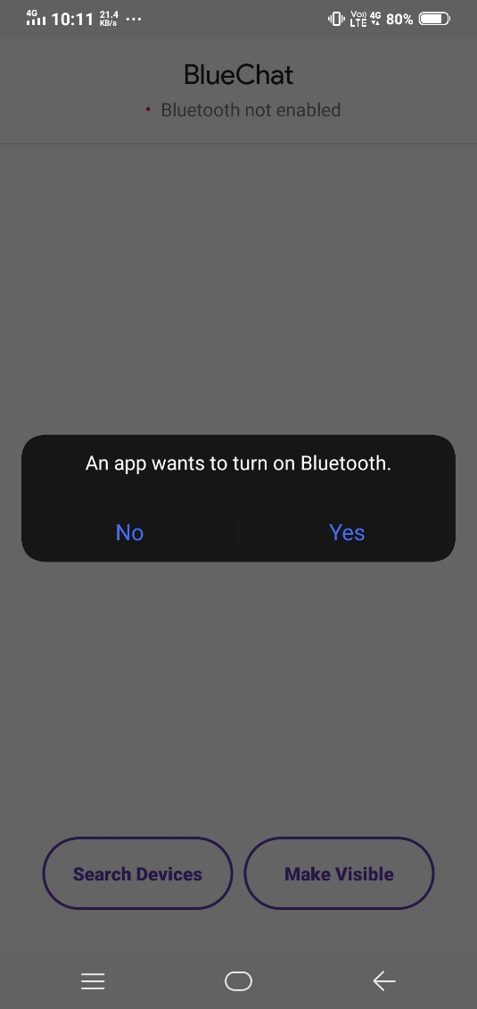
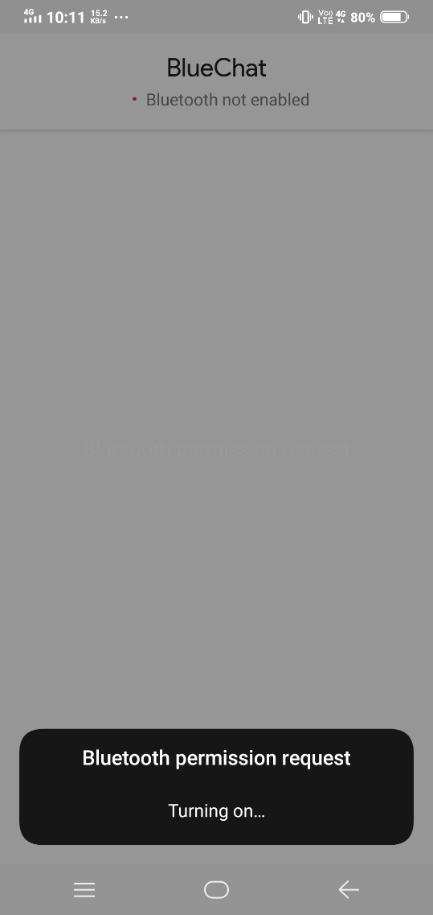

Slide 8
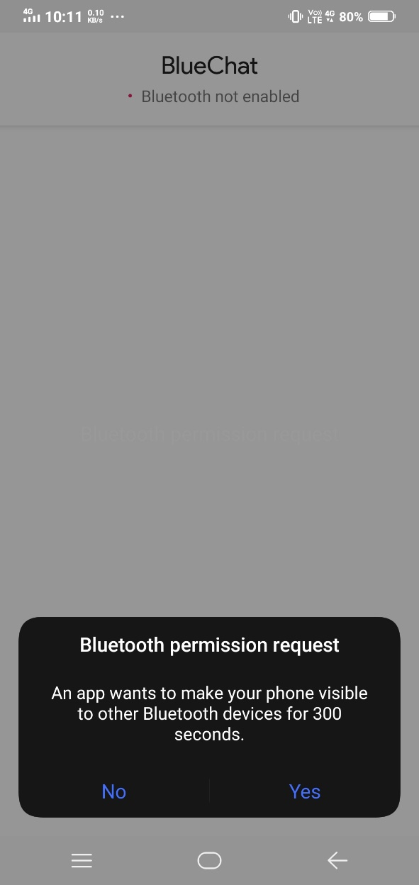
Fig: Bluetooth Discovery

Slide 9
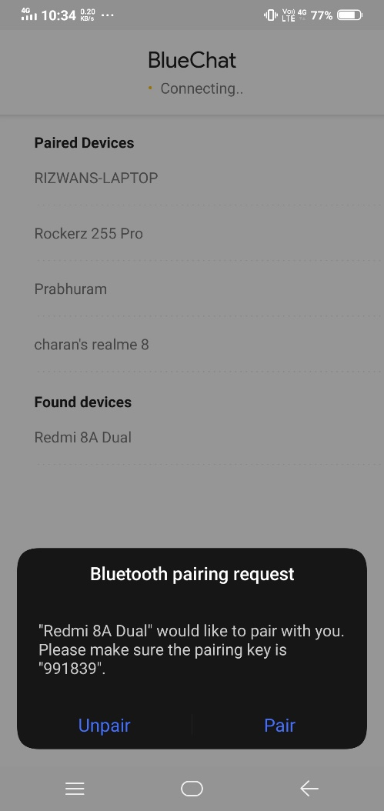
Step 6: Pairing Devices:
To connect two devices, we must implement server side and client side mechanism. One device shall open the server socket and another should initiate the connection. Both are connected when BluetoothSocket is connected on the same RFCOMM channel. During connection procedure android framework automatically shows pairing dialog.
Step 7: Connection as Client:
Create object of BluetoothSocket by calling createRfcommSocketToServiceRecord(UUID) on BluetoothDevice object.
Initiate connection by calling connect().

Slide 10
Step8: Read And Write Data
1.After establishing connection successfully, each device has connected BluetoothSocket.
2. Now one can Read and write data to the streams using read(byte[]) and write(byte[]).

Slide 11
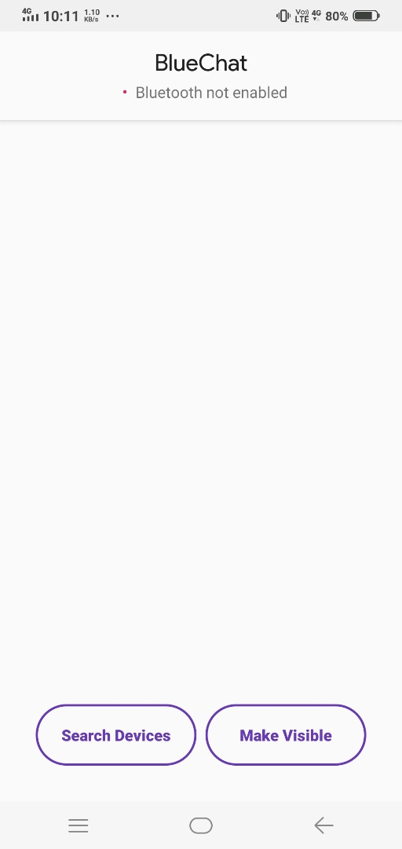
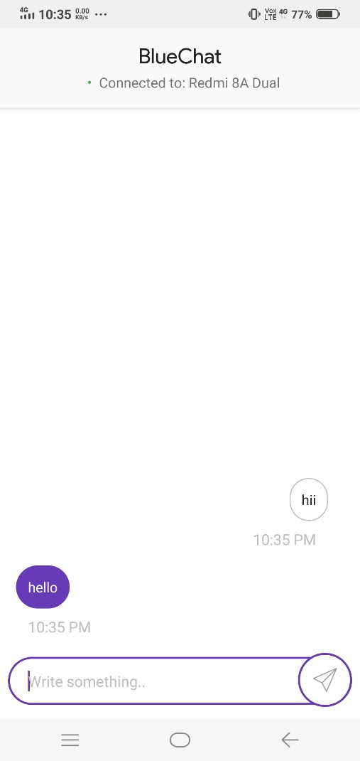
RESULT:

